Slide 1



STUDENT ISSUE
TRACKER
An AI-Assisted Complaint Management System for Universities

Slide 2
INTRODUCTION
Name: Affifa Fatima
Roll No:BSCS-E-22-05
Supervisor: Dr. Aamir Raza
BZU Multan — 2022–2026

Slide 3
ABSTRACT
The Student Issue Tracker is a web-based complaint management system developed for university departments. It allows students to submit and track complaints while providing AI-assisted category and priority suggestions. Complaints are routed to the appropriate authorities and managed through a structured workflow. The system enhances transparency, accountability, and efficiency through role-based management, analytics, notifications, and feedback features.

Slide 4
PROBLEM STATEMENT
Universities do not have a proper complaint management system.
Complaints are submitted through paper forms, emails, or verbal communication, which are informal methods.
Students cannot track the status of their complaints.
Records are often lost or ignored.

Slide 5
PROJECT OBJECTIVES
Develop a centralized complaint management system.
Provide AI-based suggestions for complaint categories and priority levels.
Implement role-based dashboards for Students, HOD, DSA, Faculty, and Supervisors.
Enable complaint tracking, notifications, analytics, and feedback features.

Slide 6
SYSTEM ARCHITECTURE
The system follows a 3-tier architecture.
Presentation (Next.js)
Application (API Routes + Auth)
Data (Supabase)
Each layer communicates through secure API calls with role-based access control.

Slide 7
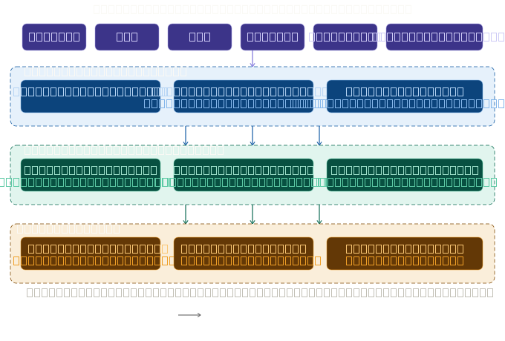
SOLID ARROWS SHOW REQUEST FLOW; EACH LAYER IS INDEPENDENT AND COMMUNICATES ONLY WITH ADJACENT LAYERS

Slide 8
TECHNOLOGY STACK
Frontend: Next.js, React, CSS
Backend: Next.js API Routes
Database: Supabase PostgreSQL
Auth: Supabase Auth
Extras: Gmail SMTP, Botpress, Speech Synthesis, Lucide Icons

Slide 9
FUNCTIONAL REQUIREMENTS
Student: submit, track, feedback
HOD: review academic/behavior complaints
DSA: review admin/facilities complaints
Faculty: resolve assigned complaints
Supervisor: manage all + analytics

Slide 10
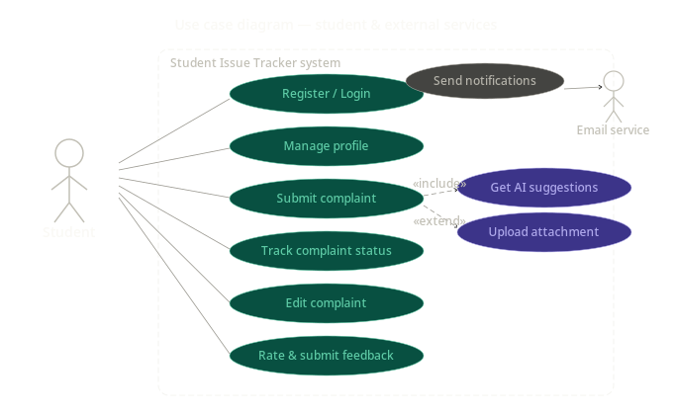
USE CASE
(STUDENT)
STUDENT ACTOR INTERACTIONS INCLUDING AI-ASSISTED COMPLAINT SUBMISSION, STATUS TRACKING, AND FEEDBACK

Slide 11
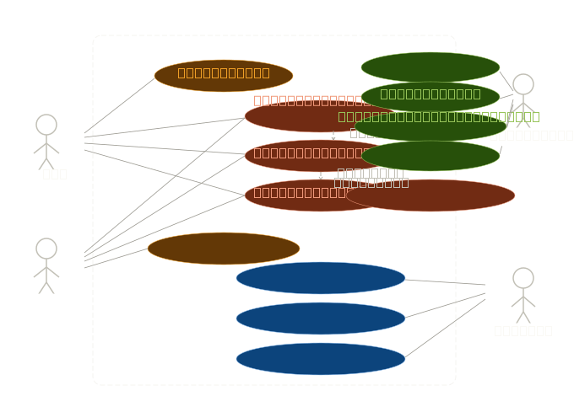
USE CASE
(STAFF)
STAFF ROLE INTERACTION HOD AND DSA REVIEW AND ROUTE COMPLAINTS , FACULTY RESOLVES AND SUPERVISOR MANAGES THE ENTIRE SYSTEM.

Slide 12
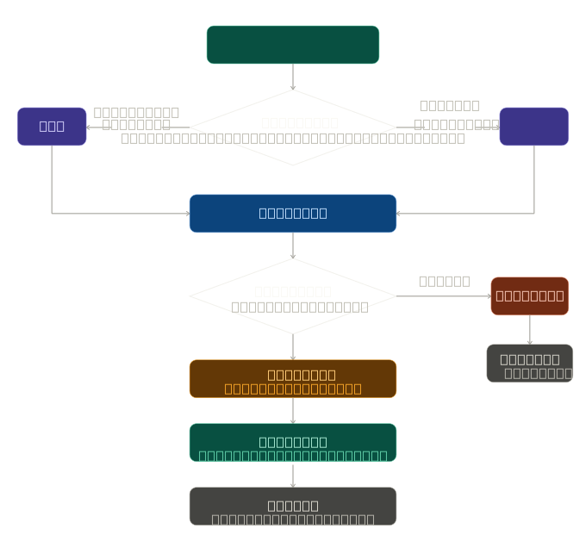
WORKFLOW

Slide 13
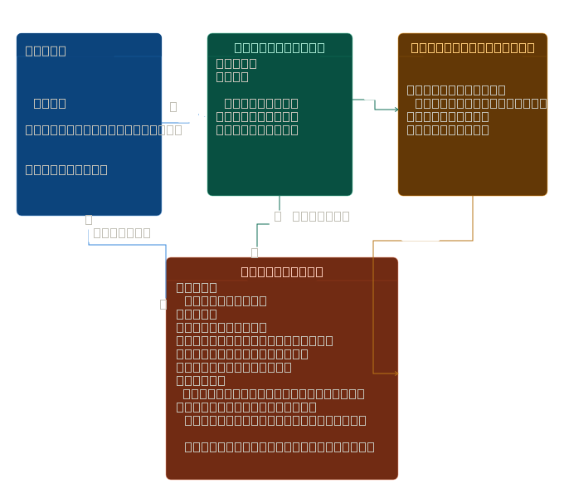
ERD
(CORE TABLES )
THESE ARE THE BACKBONE OF THE SYSTEM WITH FOREIGN KEY RELATIONSHIPS

Slide 14
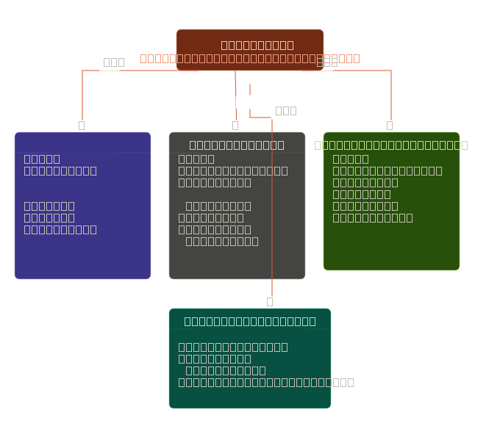
ERD
(SUPPORTING TABLES )
ALL THESE LINK BACK TO THE CENTRAL COMPLAINTS TABLE WITH (1:M) RELATIONSHIP.

Slide 15
AI ASSISTANCE FEATURE
Keyword-based category prediction
Urgency analysis for priority (Low/Medium/High)
Similarity detection to reduce duplicate complaints
Lightweight JS utilities — no external ML server

Slide 16
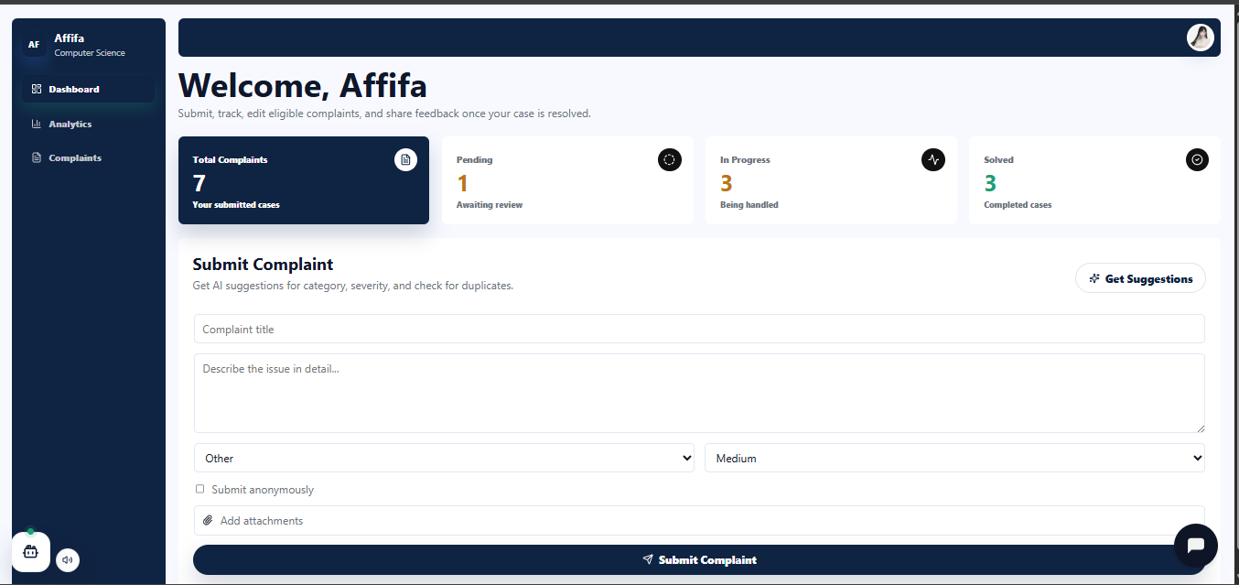
UI
Student Dashboard with Botpress Chatbot + Voice Assistant

Slide 17
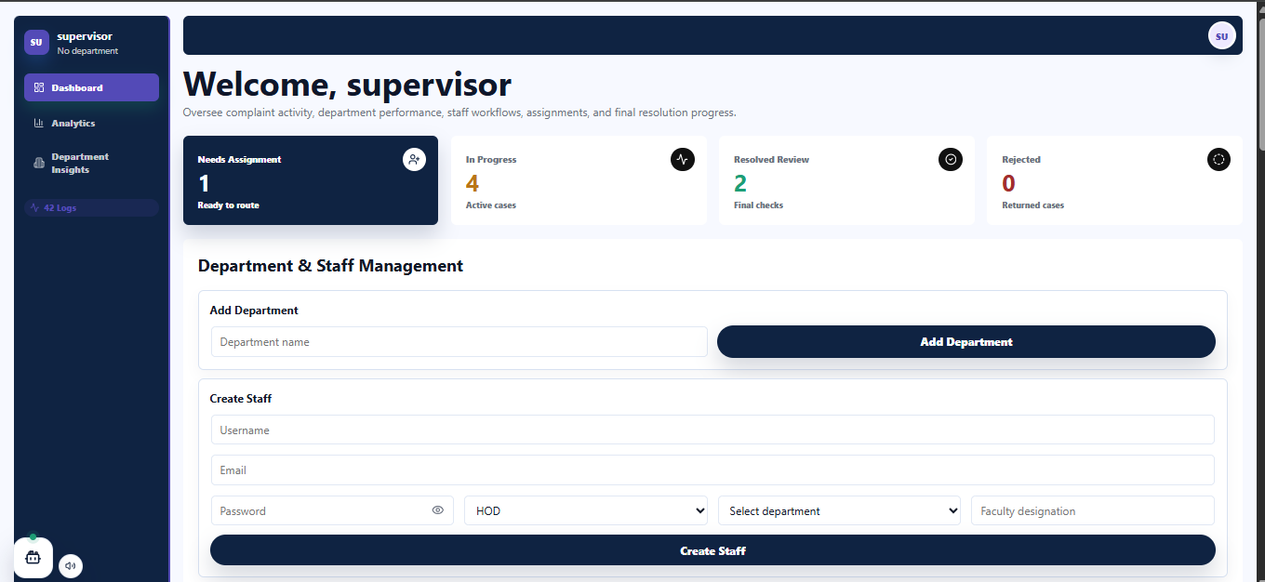
UI
Supervisor Dashboard where departments can be added and HODs and DSAs are assigned

Slide 18
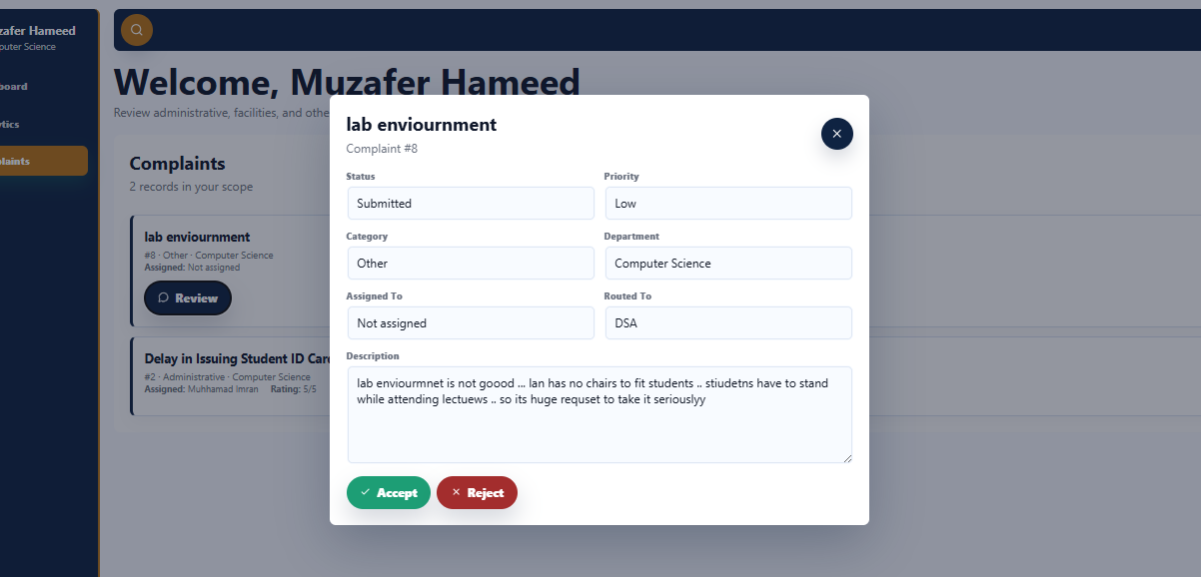
UI
Review Modal in DSA and HOD Dashbord

Slide 19
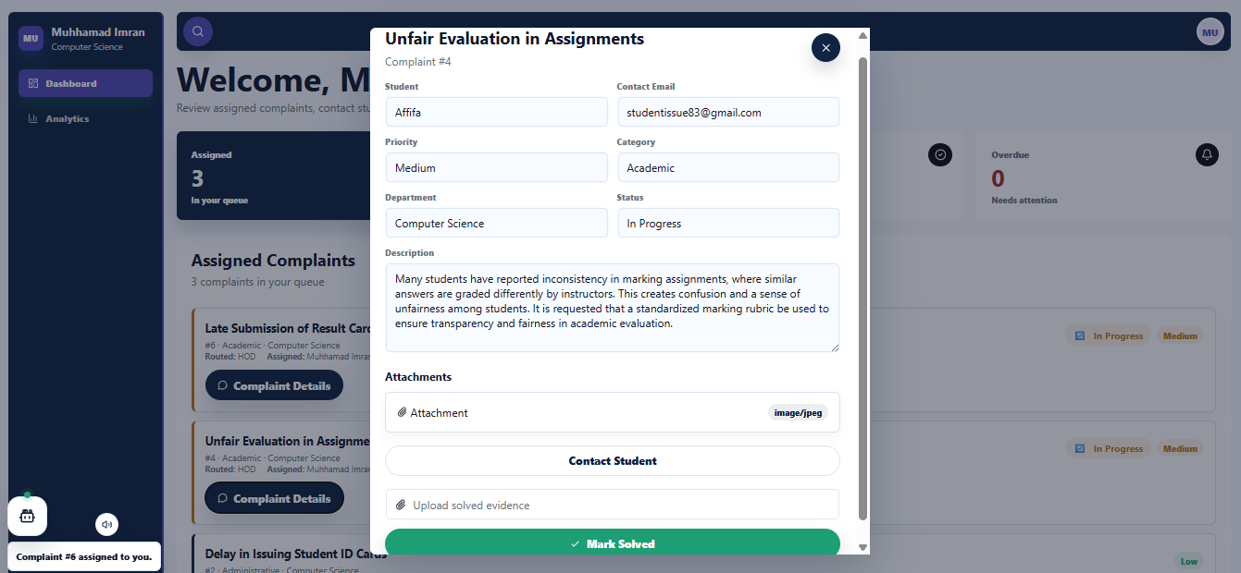
UI
Faculty Complaint Details Model

Slide 20
CONCLUSION
Successfully developed a centralized, role-based complaint management system for universities
AI-assisted category and priority suggestions reduce manual effort and improve accuracy
Real-time complaint tracking ensures transparency for students and accountability for staff
Automated routing (Academic/Behavior → HOD | Admin/Facilities → DSA) eliminates manual sorting
Integrated notifications, feedback, and analytics provide a complete complaint lifecycle solution
Lightweight JS-based AI — no external ML server required, fully deployable within university infrastructure

Slide 21
FUTURE WORK
Mobile app (Android / iOS) for easier student access
Deep learning NLP for smarter complaint classification
PDF report generation for department heads
Multi-campus support for larger universities
Real-time WebSocket notifications

Slide 22
THANK
YOU

